Slide 1

ATLAS
You CAN stargaze.
Tonight. Anywhere. With the phone already in your pocket.
Liam Martin · European Innovation Academy · youratlas.cc
Notes:
Three years ago I was carrying a telescope worth more than my car. Tonight, all I carry is my phone. This is Atlas — the app that tells you: yes, you CAN stargaze, tonight, from exactly where you are.

Slide 2



WHY I'M BUILDING THIS
A professional in this industry, building the app he needed
CTO, Copernic Space
“I’ve spent thousands of francs on telescopes. Right now I live out of a suitcase — just my eyes and a smartphone. Atlas is the app I wished existed on every one of those nights.”
Aerospace startup — designed the payload interface for an unmanned lunar mission.
Lead engineer, fraud prevention
Built consumer anti-scam technology in partnership with Mastercard and NAB.
— Liam Martin, Founder
Founder, Signal Kinetics
Building space & science products since 2020 — 2,000+ users across the ecosystem.
ATLAS · EUROPEAN INNOVATION ACADEMY
01
Notes:
I've spent my career in this exact space — designing the payload interface for an unmanned moon mission as CTO of Copernic Space, building fraud-prevention technology with Mastercard and NAB, and running my own space-education startup since I was eighteen. But Atlas didn't come from a boardroom. It came from standing outside, phone in hand, not knowing where to look.

Slide 3



THE PROBLEM
Curiosity dies at “I don’t know where to start.”
What’s even visible tonight?
Is it worth going outside?
Where do I even point my phone?
Existing apps hand beginners the entire sky — thousands of stars, one giant catalog — and expect them to know what to do with it. That’s choice paralysis, not guidance. One confusing, cloudy night, and most people never try again.
“Most visitors landed on the page and never went further.” — early Atlas analytics, before the plain-language rebuild
ATLAS · EUROPEAN INNOVATION ACADEMY
02
Notes:
Here's the problem: astronomy apps hand beginners the entire sky — every star, every catalog entry — and expect them to figure it out. That's not guidance, that's paralysis. People assume they need a telescope, get overwhelmed, and go back inside. One bad night, and they never try again.

Slide 4
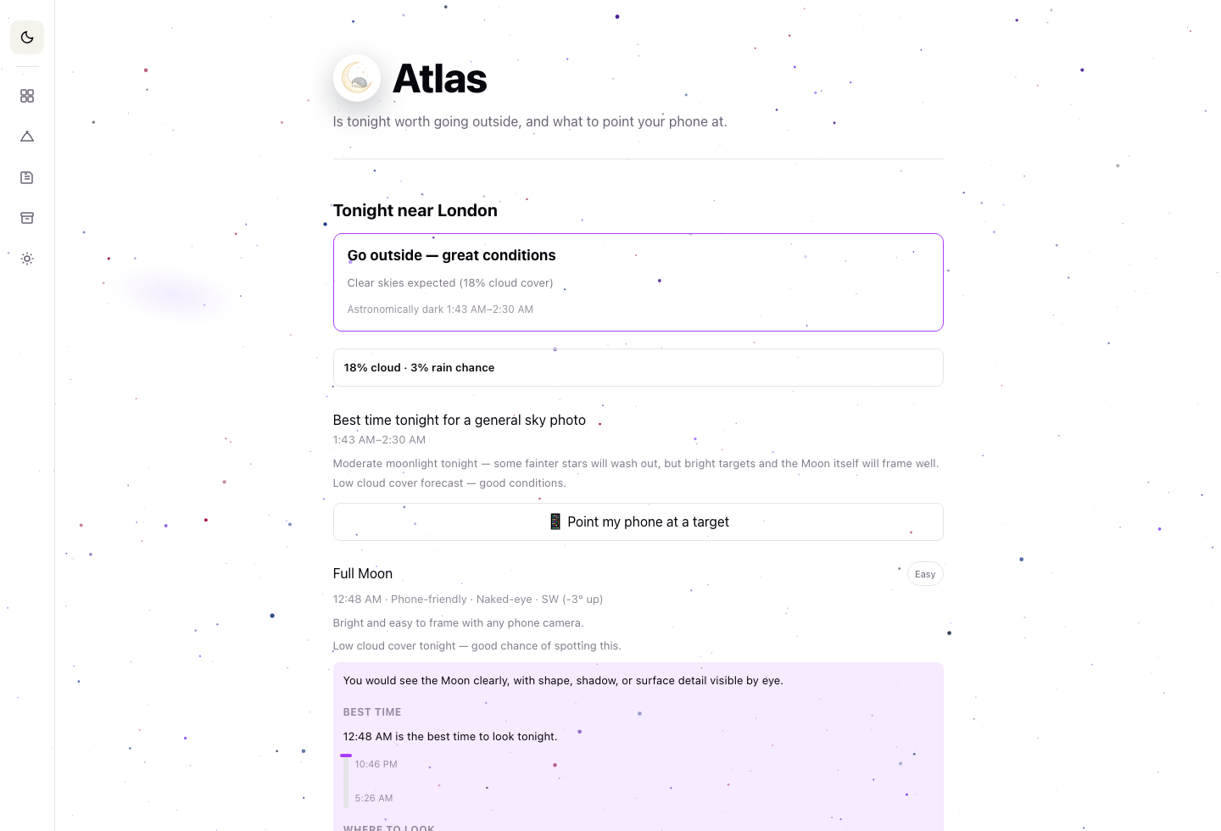
THE SOLUTION
Not the whole sky. Just the part that matters tonight.
Atlas takes the maths of astronomy — altitude, magnitude, moonlight, cloud cover, timing — and turns it into one sentence a beginner can act on tonight.
“You would see the Moon clearly, with shape, shadow, or surface detail visible by eye.”
— what Atlas told a beginner in London, tonight
90% of the sky. In plain language. For free.
ATLAS · EUROPEAN INNOVATION ACADEMY
03
Notes:
Atlas does the opposite. It takes the maths — altitude, moonlight, cloud cover, timing — and turns it into one sentence: you'll see the Moon clearly tonight, southwest, low on the horizon. We're not giving you 100% of the sky. We're giving you the 90% that's actually visible tonight — free, with the phone already in your pocket.

Slide 5
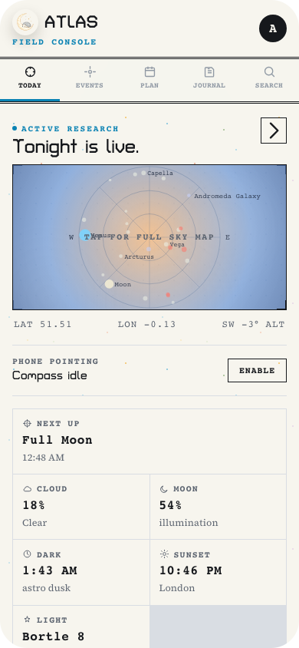
THE FEATURE THAT SELLS ITSELF
100%
of free users opened Plan — the trip planner
All but 4 started subscribing on the spot.
Plan bundles the best time, the exact direction, dark-sky conditions, and phone-specific camera settings into one page. It's the moment a beginner realizes this is a real, usable plan — and the moment they pay for the deeper version.
ATLAS · EUROPEAN INNOVATION ACADEMY
04
Notes:
The Plan feature is where this clicks. It bundles the best time, the exact direction, and phone-specific camera settings into one page. Every single free user opened it. All but four started subscribing on the spot. We didn't have to sell this feature — it sold itself.

Slide 6


COMMUNITY
From a photo online to a night under real skies
→
→
Share what you saw
Find your people
Meet under a real sky
Photo challenges and journal entries turn one good night into visible proof.
The community feed surfaces nearby beginners and local astrophotographers.
The pull is toward an actual dark-sky meetup — not another feed to scroll.
Not a dig at anyone stargazing solo from a remote spot — that’s still a full Atlas experience. But for everyone who can meet up, Atlas should gently open that door, not keep them scrolling.
ATLAS · EUROPEAN INNOVATION ACADEMY
05
Notes:
Journal entries, photo challenges, a community feed — they're not there to keep people scrolling. They're there to build confidence until someone's ready to meet other stargazers in person, at a real dark-sky site. Online is the on-ramp, not the destination — and for the many of us in remote places, both still matter.

Slide 7

TRACTION
Two weeks. Real strangers. Real money.
Since 14 July 2026 — zero ad spend.
75
61
CHF 1,028
11
total signups
paying customers
revenue collected
paying strangers*
1,254 Instagram story views → 40 clicks straight into the app
from five Stories in a single week, on a personal account.
*8 paying customers with no personal relationship to the founder, + 3 from an Amsterdam astronomy group.
ATLAS · EUROPEAN INNOVATION ACADEMY
06
Notes:
In the two weeks since July 14th, that loop already works: 75 signups, 61 paying customers, CHF 1,028 in revenue — with zero ad spend. Eight of those customers have never met me. Three came from an astronomy group in Amsterdam I barely know. One Instagram story cycle brought 1,254 views and 40 people straight into the app.

Slide 8



WHAT'S NEXT
Three ways this grows from here
Mentor-validated
Affiliate & gear partners
Group & dark-sky tours
Subscriber growth flywheel
Telescope, camera, and binocular partners give users a path into better gear — without needing to own it outright.
The single angle every mentor has flagged as the most exciting — ticketed, in-person nights at real dark-sky sites.
A zero-budget content engine — YouTube Shorts and The Daily Transit — already turning strangers into subscribers.
ATLAS · EUROPEAN INNOVATION ACADEMY
07
Notes:
Where this goes next: affiliate partnerships with telescope and camera makers, so users can borrow their way into better gear. Dark-sky group tours — the single angle every mentor I've spoken to has flagged as the most exciting. And a zero-budget content engine already turning strangers into subscribers, one video at a time.

Slide 9
You CAN stargaze.
Tonight. Anywhere. With what’s already in your pocket.
youratlas.cc · Liam Martin · liam@skinetics.tech
Notes:
Atlas exists to say one thing to anyone who's ever looked up and felt lost: you CAN stargaze. Tonight, anywhere, with what's already in your pocket. Thank you.

